Slide 1
Amex Coupon redemption
Supervised machine learning : Binary Classification algorithm
Team Name : Group four
Contributors : Ramesh, Girish, Sunit, Jainam

Slide 2
Problem statement
XYZ Credit Card company regularly helps it’s merchants understand their data better and take key business decisions accurately by providing machine learning and analytics consulting.
ABC is an established Brick & Mortar retailer that frequently conducts marketing campaigns for its diverse product range. As a merchant of XYZ, they have sought XYZ to assist them in their discount marketing process using the power of machine learning.
Discount marketing and coupon usage are very widely used promotional techniques to attract new customers and to retain & reinforce loyalty of existing customers. The measurement of a consumer’s propensity towards coupon usage and the prediction of the redemption behaviour are crucial parameters in assessing the effectiveness of a marketing campaign.
The retailer would like the ability to predict whether customers redeem the coupons received across channels, which will enable the retailer’s marketing team to accurately design coupon construct, and develop more precise and targeted marketing strategies.

Slide 3
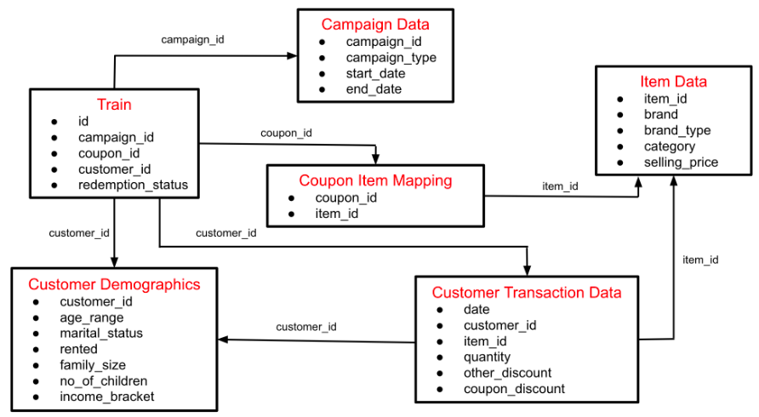
Dataset and Data dictionary (List of features available for analysis and prediction) Dataset Description Here is the schema for the different data tables available.

Slide 4
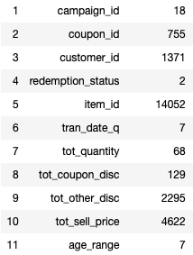
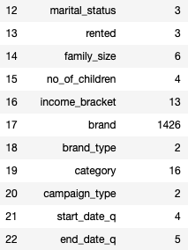
Dataset and Data dictionary (List of features available for analysis and prediction) describing the data in statistical way
ID as a feature seems no significance and there is already a field of Customer Id to uniquely identify the customer. We would be dropping the feature from analysis as it does not seem to add value to learning algorithm.
Customer Transaction data is merged with Coupon data to uniquely identify transactions basis Coupon ids as well.
Customer Transaction data is aggregated basis Customer Id, Item Id, Coupon Id, Transaction Date (converted to quarter) for Total Quantity bought, Total Selling Price, Total Coupon Discount, Total Other Discount.

Slide 5
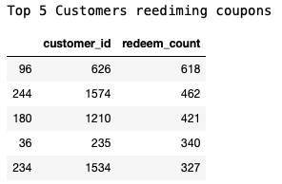
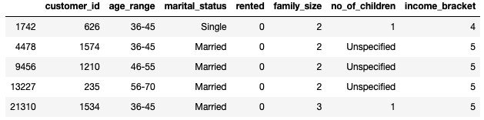
Exploratory Data Analysis – customer id and it’s attributes and significance to Coupon redeem
Basis observation for top 5 Customers redeeming coupons, we could create below hypothesis for attributes:
Age Range of 36 to 55 has no significant association with Coupon Redemption.
Marital Status of ‘Married’ has no significant association with Coupon Redemption.
Family Size of 2 (Married Couple) has no significant association with Coupon Redemption.
Customer living on rent or not has no significant association with Coupon Redemption.
No of Children has no significant association with Coupon Redemption.
Income Bracket of 5 has no significant association with Coupon Redemption.

Slide 6
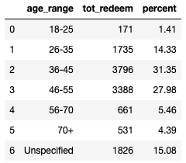
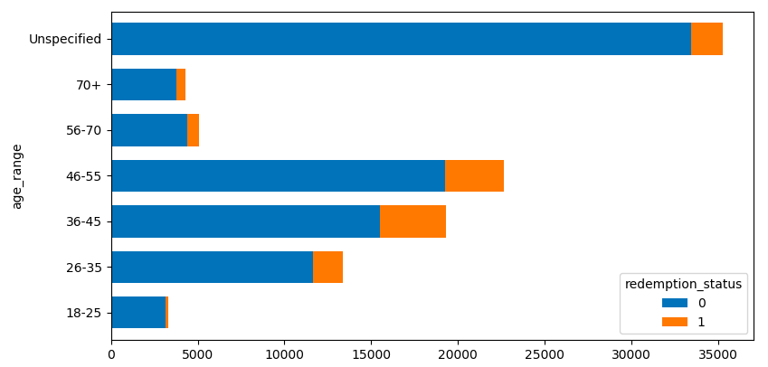
Exploratory Data Analysis Age Range of 36 to 55 has no significant association with Coupon Redemption.
Inference : We could see association between Age Range of 36 to 55 and tendency towards Coupon Redemption when compared with rest other Age Range in terms of percentage.

Slide 7

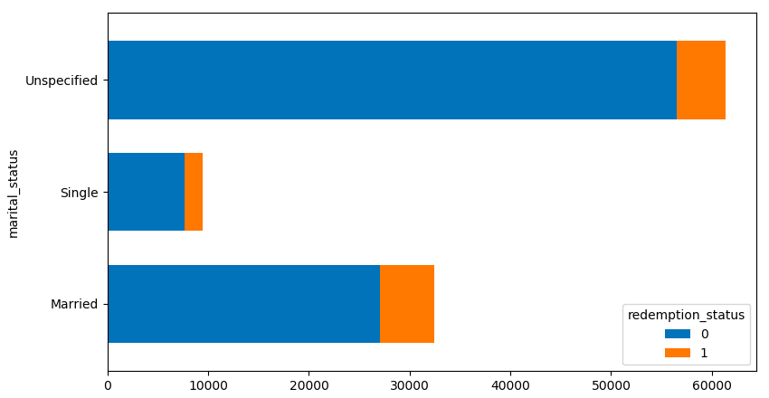
Exploratory Data Analysis Marital Status of ‘Married’ has no significant association with Coupon Redemption.
Inference : As most of the customers haven't mentioned their marital status it is difficult to support that Married customer redeem more. But basis available data, we could see Married people are mostly using coupons to redeem. So at this stage I could think of giving more weightage to a person which has discloses marital status as Married.

Slide 8
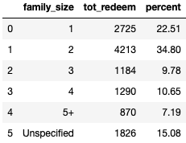
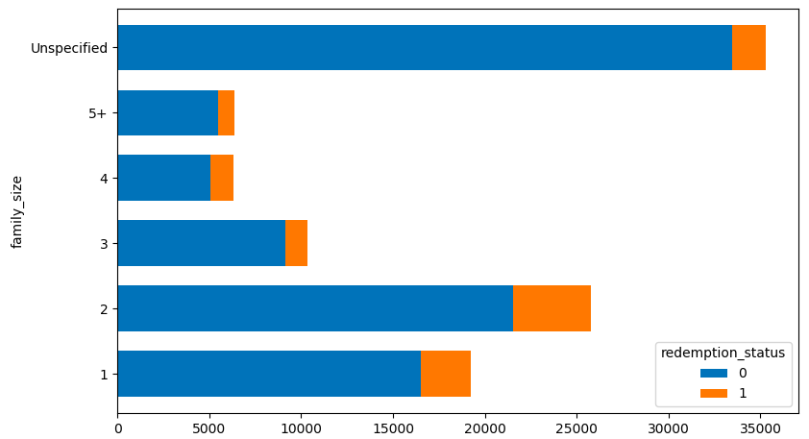
Exploratory Data Analysis Family Size of 2 (Married Couple) has no significant association with Coupon Redemption.
Inference : Considering family size of 2 or more as a married couple (and transforming that ratio on to Marital Status data of Unspecified), then we could make an assumption over here that Married couple are mostly using the coupons to redeem.

Slide 9

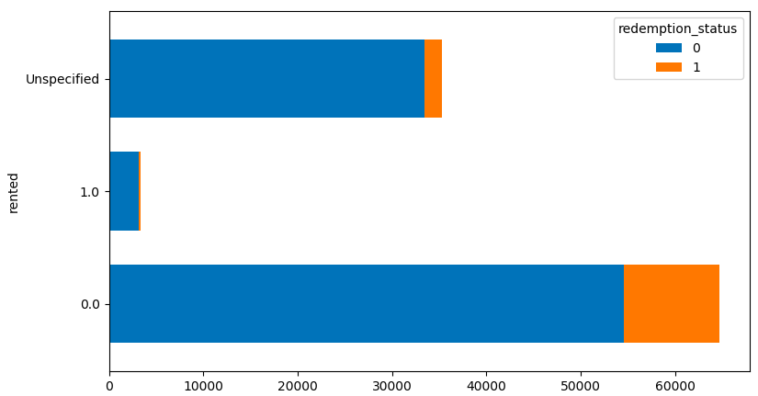
Exploratory Data Analysis Customer living on rent or not has no significant association with Coupon Redemption.
Inference : Maximum people have provided status as not rented so we could assume more weightage to such customers as they have shown greater tendency towards redemption of the coupons.

Slide 10
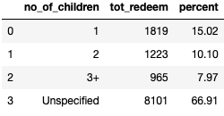
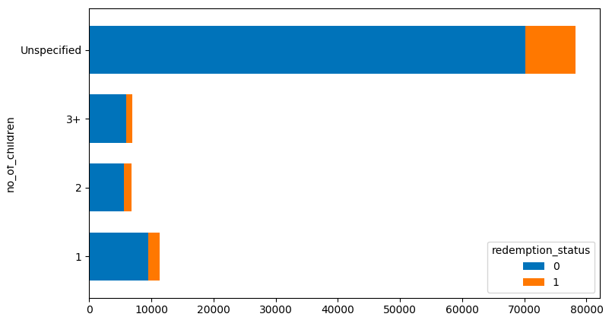
Exploratory Data Analysis No of Children has no significant association with Coupon Redemption
Inference : Since most of the customers preferred not to disclose on number of children, at this point we can assume that this field has no significance with redemption of coupons.

Slide 11
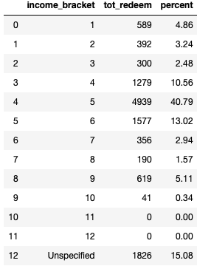
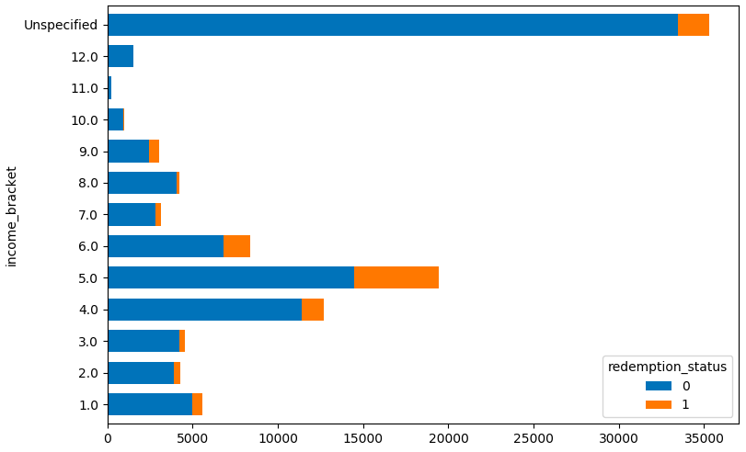
Exploratory Data Analysis Income Bracket of 5 has no significant association with Coupon Redemption.
Inference : Assuming 5 as mid income group, customers in this group clearly shows behaviour towards redemption of coupon.

Slide 12
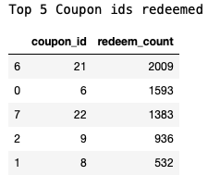
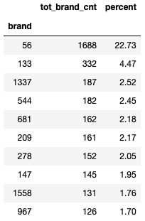
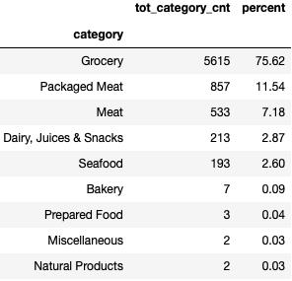
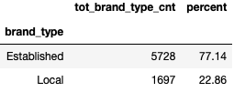
Exploratory Data Analysis – COUPON id and it’s attributes and significance to Coupon redeem
Basis observation for top 5 Coupon Id’s redeemed most, we could create below hypothesis for attributes:
Brand 56 has no significant association with Coupon Redemption.
Brand Type of ‘Established’ has no significant association with Coupon Redemption.
Category has no significant association with Coupon Redemption.
Campaign Type as ‘X’ has no significant association with Coupon Redemption.

Slide 13
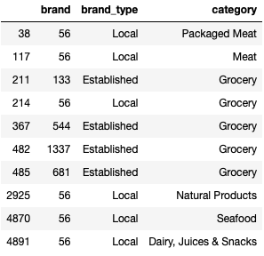
Exploratory Data Analysis Brand 56 has no significant association with Coupon Redemption.
Inference: For brand 56, there is a wide range of category available under the umbrella of Food products and displays greater tendency towards coupon redemption as well. Even rest other top 4 brands as well belong to general food product category under Grocery.

Slide 14

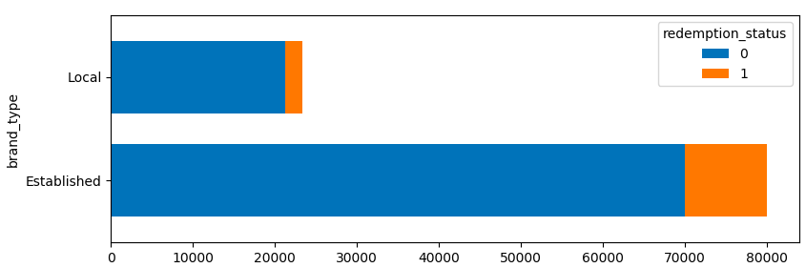
Exploratory Data Analysis Brand Type of ‘Established’ has no significant association with Coupon Redemption.
Inference: Coupon redemption percentage seems high when associated with an Established brand type.

Slide 15
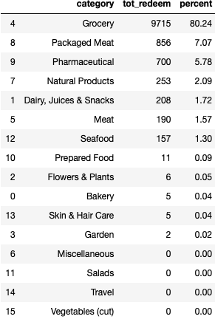
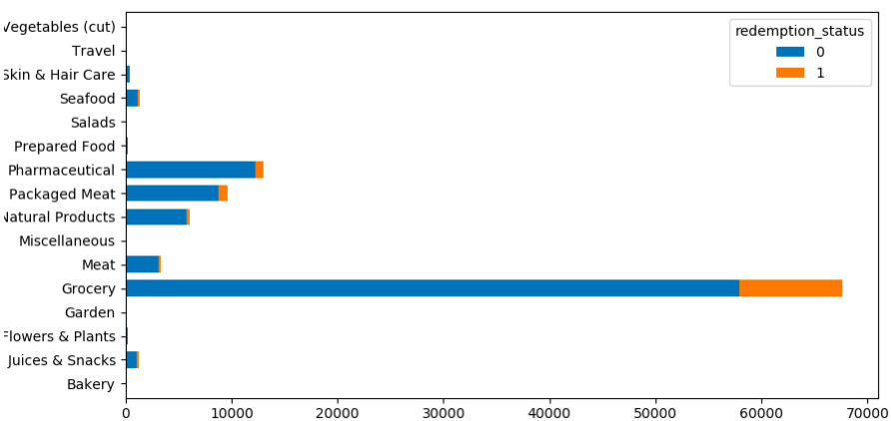
Exploratory Data Analysis Category has no significant association with Coupon Redemption.
Inference : Grocery, Packaged Meat, Pharmaceutical, Natural Product, Dairy & Juice and Meat are the category seems more associated with coupon redemption.

Slide 16

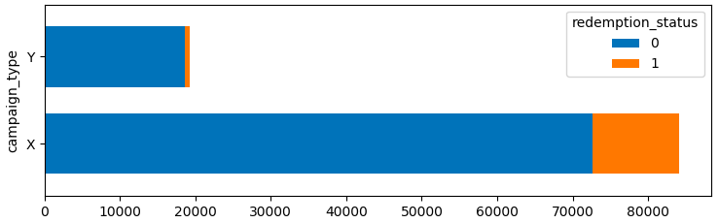
Exploratory Data Analysis Campaign Type as ‘X’ has no significant association with Coupon Redemption.
Inference : Campaign type of X seems to have more associated with coupon redemption.

Slide 17
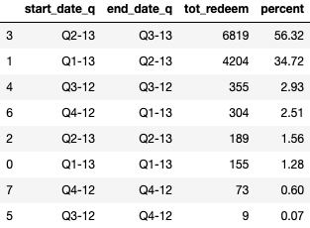
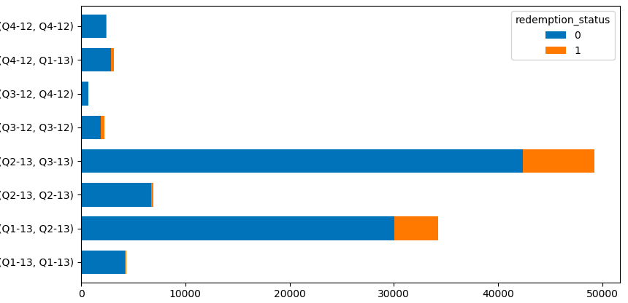
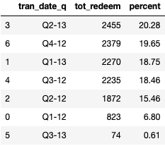
Exploratory Data Analysis coupon redemption trend basis campaign start date and transaction date
Inference : Campaign started between Q2-13 to Q3-13 followed by Q1-13 to Q2-13, seems more association towards coupon redemption trend. So we could assume campaign spanned across early quarters of year seem to more association with coupon redemption.
We could not clearly see association between transaction quarter and coupon redemption behaviour.

Slide 18
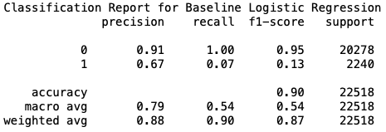
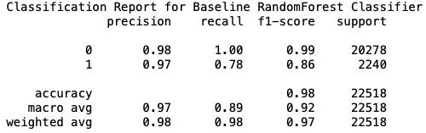
model evaluation matrix
Logistic Regression Evaluation for Baseline Model
Random Forest Classifier Evaluation for Baseline Model
Precision – What percent of your predictions were correct? Precision is the ability of a classifier not to label an instance positive that is actually negative.
Recall – What percent of the positive cases did you catch? Recall is the ability of a classifier to find all positive instances.

Slide 19
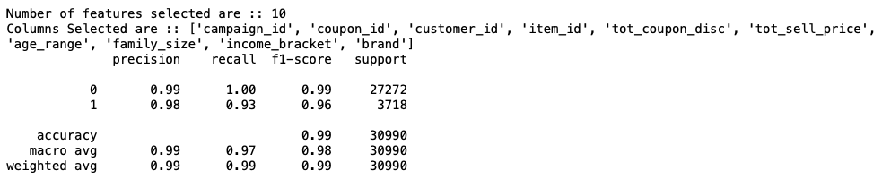
model evaluation matrix
Random Forest Classifier Evaluation for Final Model with RFE and GridSearchCV

